Slide 1

Water-M : Presentation
Unified Intelligent WATER
Jean-Jacques Busson (éolane) – Serge Dedeystere (IMT)

Slide 2

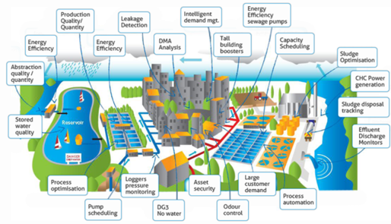



Many Needs – Many Users
Municipality
Households
Industries
Water Utilities
Tertiary
Businesses
Farms
One Unified Architecture

Slide 3
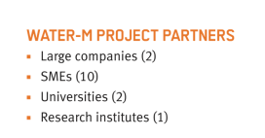
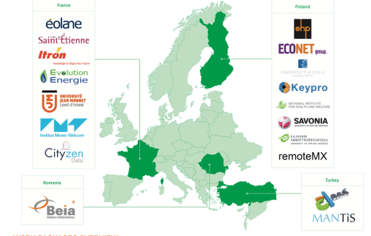
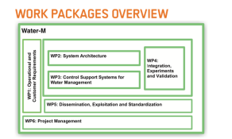
Water-M
Unified intelligent water

Slide 4


Technology
End points
Sensing BAT study
Networks
Urban and dense WSN
Middleware
Time series
Applications
Energy management (Battery life)
Data logging
Remote configuration (Calibration)
Local intelligence (Alarms)
Rural and scatterred WSN
Custom On-the-fly data processing
Highly scalable
Open Source
Data analytics
Event Stream Processing and Complex Event Processing
Forecast
Simulation
Visualisation

Slide 5
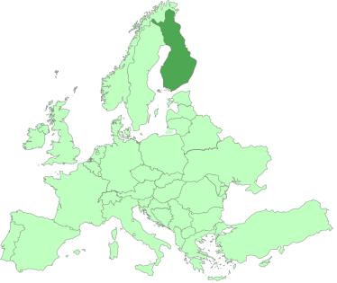
Applications and pilots
Network
Monitoring + Optimization
Kuopio

Slide 6
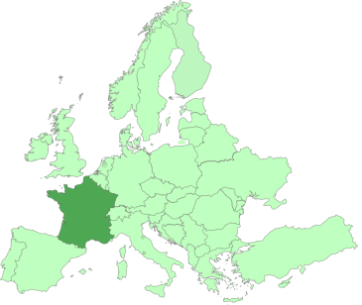
Applications and pilots
Network
Monitoring + Optimization
Kuopio
St-Etienne

Slide 7
Applications and pilots
Oulu
Water
Quality
Kuopio

Slide 8
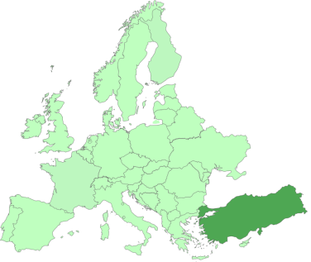
Applications and pilots
Waste Water
Management
Ankara

Slide 9
Applications and pilots
Urban
Farming
Kuopio
Le Perray

Slide 10
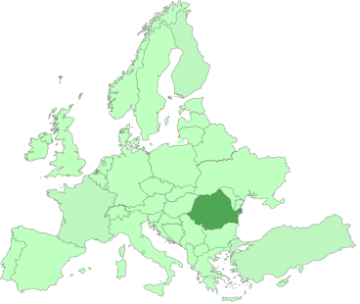
Applications and pilots
River Monitoring and flood alerts
Bucharest

Slide 11
Follow-up
 | Travaux
 | WP1: Operational and Customers Requirements
 | WP2: System Architecture
 | WP3: Control Support Systems for Water Management
 | WP4: Integration, Experiments and Validation
 | WP5: Dissemination, Exploitation and Standardization
 | WP6: Project Management

Slide 12
Thank you for your attention
We value questions

