Slide 1
X
Title:
4.2 Exploitation Plan of EU Acceleration Platform (Version 1)
Version : 1
Date : 30/09/2016
Pages : 19
A platform for the acceleration of go-to market in the ICT-industry
Author:
George Suciu, Cristina Ivan, Lavinia Panait
Organisation:
BEIA Consult, SIVECO Romania SA
The Accelerate consortium consists of:
AAC Global, Aptual, Beia, Bittium Wireless, Cognistreamer, F-Secure, Inno-W, Lappeenranta University of Technology, PlanetMedia, Sirris, Siveco, Sivsa, Commscope Connectivity, Tobagos, University of Mondragon, Vifib, VTT and Zenjoy
Printed on:
30/09/2016
Status:
[ [ [ | x | ] ] ] | Draft To be reviewed Final / Released
Confidentiality:
[ [ [ | x | ] ] ] | Public Restricted Confidential | - Intended for public use - Intended for Accelerate consortium only - Intended for individual partner only
Deliverable ID: D4.2
Title: Exploitation Plan of EU Acceleration Platform
Summary / Contents:
Slides 2-3: Introduction
Slide 4: Our Mission
Slide 5: Concept
Slide 6: Objectives
Slide 7: Status
Slide 8: Stakeholders
Slides 9-10: Competition
Slide 11: SWOT Analysis
Slides 12-16: Marketing Plan
Slide 17: Exploitation Options
Slide 18: Short and long term forecast
Slide 19: Sustainability rights
Slide 20: Intellectual Property Rights
Slide 21: Conclusions
© Copyright Accelerate Consortium

Slide 2
Introduction
For a successful project lifecycle, dissemination and exploitation related activities are of utmost importance. While dissemination activities are performed throughout the whole duration of the project, the exploitation plan concentrates on the project’s results during the last phase and afterwards, to reach sustainability after the project ends.
The present document aims to serve as a foundation for sustainable exploitation of the Global Acceleration Platform. More specifically:
It aims to initially present the concept of the Acceleration Platform: mission, concept, objectives, stakeholders and a brief status of the developments.
The document further presents the results related to the analysis performed on the key strengths, weaknesses, opportunities and threats.
finally, a marketing and exploitation plan completes the present document.
Exploitation

Slide 3
Introduction
Our main goal was to develop an on-going work plan for setting up the main exploitation aspects of the Global Acceleration Platform and to establish suitable actions to make it successful, sustainable and long lasting.
To do this:
2
the PCC asked the Romanian Consortium, represented by SIVECO Romania and BEIA, to take the lead in the writing of the exploitation plan and gather all the necessary data for the exploitation of the Global Acceleration Platform;
The analysis of the data allowed the Romanian Consortium to identify strong and weak points related to the Global Acceleration Platform for the intended target groups;
1
the Project Co-ordination Committee (PCC) had brainstorming meetings to assess and identify the target groups for the exploitation of the Global Acceleration Platform.
4
Once the key strengths and opportunities have been identified, we tried to match them to create capabilities that can be developed into competitive advantages for the Global Acceleration Platform.
3

Slide 4
Our Mission
The Acceleration Platform aims to enable the knowledge transfer on a massive scale to support companies in accelerating their businesses to reach faster to the markets, based on the users needs and demands.

Slide 5
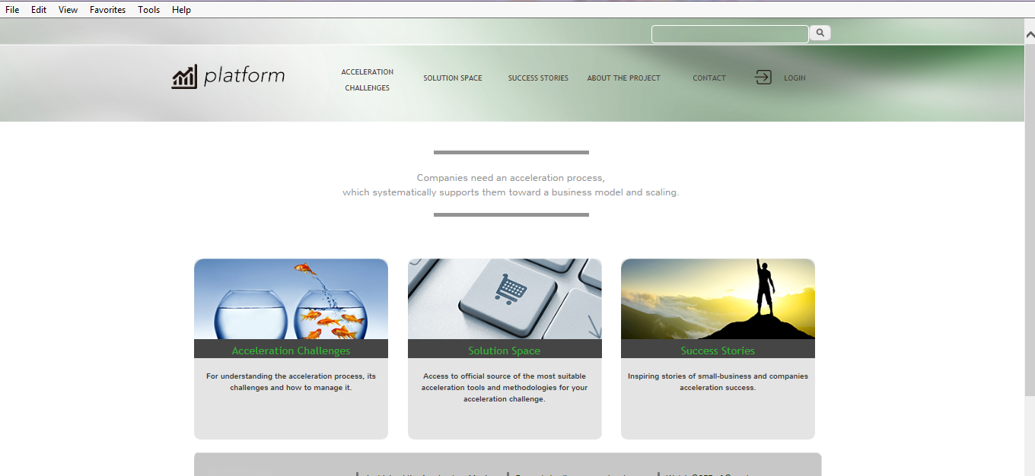
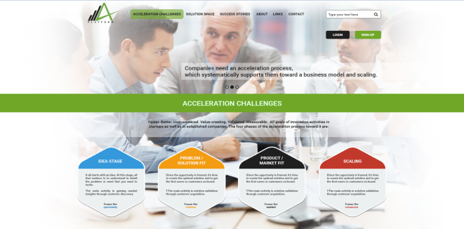
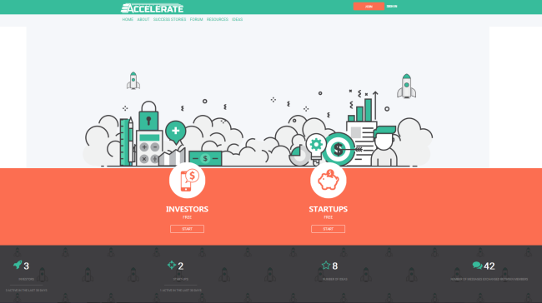
Concept of the Global Acceleration Platform
MINIMUM VIABLE PRODUCT
GLOBAL ACCELERATION PLATFORM
The initial version of the Global Acceleration Platform was the Spanish version. It was designed to pilot a first dashboard with the scope to provide guidance on the expected values that the KPIs associated to the different methodologies and tools may have in order to reflect the intended progress. The initial platform was extensively improved in terms content and design, as agreed at European Consortium level.
The new functionalities of the Global Acceleration Platform were designed to support users in emerging European countries with an innovative platform, that allows matching between the different categories of target users, such as investors and start-ups. Thus, both users who are starting up and wish to establish their own business, but they need financial support to be able to sustain the idea, and funders who wish to invest in a new profitable business, may start beneficial relationships in a fast, safe and effortless manner.

Slide 6
Objectives
The Global Acceleration Platform aims to create a solid network of startups, investors, entrepreneurs and advisors in different areas of expertise and help them collaborate in an accessible manner, without loosing precious time in looking for the appropriate partners to foster their project / product or business ideas.
To this intend, an innovative solution to introduce the matchmaking concept in Romania and emerging European Countries, was developed so as to sustain startups in their growing process on the market.
Inasmuch as the platform will extend the number of users, tools like Google Search Console have been included to optimize the search results and improve the way that potential users are directed to our business accelerator.

Slide 7
Status of the platform developments
The Global Acceleration Platform is built in Drupal and uses modules that enhance the functionality of the platform, the administrator dashboard and the front view of the site, giving a much better experience to both developers and users.
The platform provides meaningful information about the overall acceleration process, but also about the four acceleration phases, a collection of lessons learnt and resources helpful for startups on their go-to market process.
The most important functionality of the acceleration platform gives startups the possibility to access a network of entrepreneurs with expertise and advisors, with the scope to foster their growth from inception to the readiness of the product or the company emergence on the market. To this aim, an idea publishing system as well as a private messaging system were implemented as core functionalities of the Global Acceleration Platform.
Integration with LinkedIn was implemented so that the platform will automatically retrieve details for users who wish to register via LinkedIn, so they can be spared the effort of filling required data for the profile. Thus, users will find it simple to access the platform by logging in with LinkedIn existing account details.

Slide 8
Stakeholders
DEFINED ROLES
STARTUPS - any person prepared to launch a project idea; any person who already has a company, a project idea or a product, but does not have a partner; any person who doesn’t have a project idea, but wants to start a business, and seeks for guidance.
INVESTORS - any person interested in finding investment opportunities, who wants to help passionate people with knowledge and experience and/or financial support to launch a project idea.
TYPES OF USERS:
Students seeking advice from experienced entrepreneurs and specialists.
Startups with great ideas and no funding.
Entrepreneurs interested in finding investment opportunities.
Any other user seeking funding or advice on the most common entrepreneurial problems.
TARGETED SPECIALISTS (EXPERTS):
Professors
Freelancers
Consultants
Angel investors
Venture capitalists

Slide 9
Competition
Name of competitor | Key Differentiators
https://www.entrepreneur.com/ | This website serves its visitors' needs by creating relevant content, with logical information management and ease of access. Key features: it provides high advices for entrepreneurs iOS, Android Kindle and Nook editions are available it helps users to stay up to date on the latest strategies and news affecting entrepreneurs it offers multiple products and services: books, coaching and loans
https://www.b2match.com | The website facilitates set up of B2B (business to business), C2C (cluster to cluster), B2C (business to cluster) meetings. The user can create a customized registration process capable to process collection. Key features for meetings set-up: the possibility to create a website for the event and share its contents with the audience. The possibility create a recording for the event. Manage payments. The user has an overview on the participants, such as status information on their meetings and payments. The event can be promoted in the Events section of the website. Import / export of Excel / CSV files are also available.
http://matchleads.com/ | MatchLeads is a cloud application for mobile B2B matchmaking events, used by corporations, buyers, sellers, small companies, employers. The application allows organizers of the event to easily and effectively manage their own event. Key features of the application: Face-to-face meetings Open / semi-open / closed matchmaking events Possibility to schedule, accept, decline, manage and reschedule meetings Surveys, Tests, demographics, I & R Add comments and notes associated to meetings Load of pictures, videos and marketing materials Social Networking

Slide 10
Competition
Name of competitor | Key Differentiators
https://fuseami.com | Fuseami is a business networking app that helps users meet the right people at a given event; it provides advanced networking, conference agenda, spokeswoman for details and more. Key features of the application: It provides the use of intelligent search It makes proposals of professionals and allows immediate start of networking It allows full control on meetings. It can be used before, during and after the conference and informs the user about the people who attend the same event it allows a communication link with delegates, spokesmen and relevant exhibitors. It provides the user necessary information related to the conference.
http://www.eventlink360.com | Eventlink360 is a Romanian application dedicated to B2B or B2C events which aims to offer participants an innovative networking experience, interaction with organizers and speakers, a dedicated space. Participants have the opportunity to engage in debates and give feedback in real time, being an active part of the event. The organizers were able to measure in real time parameters, as well as the added value brought to events sponsors and participants. Integrated mobile platform offers all players, organizers, speakers, sponsors, media, etc. a virtual space for undertaking a interactive event, giving them a unique experience, a considerably higher number of opportunities and benefits in the events. The application is available for mobile devices.
https://www.invesdor.com/en | Invesdor is the largest equity crowdfunding platform in the Nordic region. It’s connecting European businesses with investors around the globe. Key features: solved many of the difficulties and delays associated both with raising funds and investing in new ventures easy-to-use online tool for raising funding efficiently and simultaneously growing their visibility enables easy access to a wide range of investment opportunities different methods to get a return of investment (equity and bonds)

Slide 11
SWOT Analysis
Strengths: A considerable amount of useful information will be available for the targeted users The possibility to meet experts and develop new entrepreneurial relationships, thus facilitating interactions There are several independent possible ways to generate revenue from the platform Easier profile tracking because of the integration with LinkedIn Professional Network The use of the platform is open to everyone with easy access to the material. | Weaknesses: Lack of a unified and unique regulation policy that could be applied in all participant countries in terms of fees collection and payment processing. A poor network of entrepreneurs in the piloting phase due to preconceived opinions. Delay in the launch of concrete activities and paid services Privacy concerns related to the social networking services the Global Acceleration Platform will need a lot of promotion in order to become well-known, which means extensive marketing related activities
Opportunities: The chance to put the basis of one of the first Romanian matchmaking platforms -> there are very few competitors in Romania, as well as in the emerging European countries Premium plans related to the platform may expand the most popular features and develop mobile applications. Possibility to sustain the platform future developments through the means of other research & development projects funding International markets expansion, as a long term forecast There is a strong demand for this type of platforms in the emerging European countries. | Threats: Possible low retention rate Strong Western European competition The lack of interest in pursuing the ideas and projects Too high expectations at the beginning of the project Freemium revenue model may not perform as expected for this type of product IP cloning, as well as user profile theft or IP hacking Copyright infringements Establish and maintain an active community

Slide 12
Marketing highlights
The main aspect of creating an efficient marketing campaign is to identify the benefits of the platform and the targeted audience. Also, knowing where the potential clients can be found and what channels can be used to reach them is a key factor in determining what kind of marketing campaign is better.
Amongst the most important identified benefits:
Learn how to accelerate a business or a product, by accessing meaningful information related to the acceleration process
Access to a database of lessons learnt and other helpful resources
Access to a collaborative online workspace where passionate entrepreneurs help each other to bring ideas to life
Access to specialists, investors and consultants with the appropriate knowledge, experience and financial means to help start-ups launch their project ideas.

Slide 13
Marketing highlights
In order to attract as much users as possible, the consortium will take advantage of the online promotion channels, which are much more targeted, cost-effective and have measurable results.
Online advertising includes email marketing, social media marketing, search engine marketing, mobile marketing and an array of display marketing techniques, such as banner ads, pop-ups, etc.
The Acceleration platform will be promoted via social and professional networks (mainly through Facebook, Twitter, LinkedIn). For these reasons it is crucial for us to establish a strong presence in the social media.
Another goal will be to be ranked at the top in the major search engines, and practice good Search Engine Optimization (SEO) techniques. In that way, anyone searching for the relevant entrepreneurial content will be able to see Accelerate platform as one of the first results of their search.
Google AdWords for paid advertising will also be used. It is important to convert clicks, so a landing page can be an useful method of increasing the rate of conversion and gaining more customers in the platform. According to Google AdWords planning tools, 100 EURO per month can convert from one to three visitors into new premium users on the platform per month.
Another method is using affiliate marketing, the advantage being that the campaign budget can be dynamic meaning that an affiliated members is paid only when a conversion is made.
Besides the online campaigns, the members of the project will continue to promote the platform in meetings, workshops, conferences and other events where disseminating the Accelerate Platform can increase the number of visitors and premium users.
Viral marketing can play an important role, so it is crucial to have satisfied users who will talk about the Acceleration Platform and its services to their friends and colleagues.
It is important to build a responsive opt-in email list, which we will use in order to send informative newsletters to entrepreneurs and other interested parties, about new content, ideas, and other services.

Slide 14
Marketing highlights
Why should startups join and subscribe to the platform facilities?
Because it provides real advantages to startups in the process of go-to market by facilitating the meeting with experts in certain disciplines or subjects and offering the option of chatting in a private message room.
It allows the startups to add ideas and manage them. Moreover, they are free to present the information at their own will. They can access the forum pages with threads of discussions.
Why should investors or advisers join the platform?
Because they can search for ideas, they receive meaningful notifications, they can use the forum by initiating lists of discussions with topics that can be followed by users using specific criteria.

Slide 15
Subscription Advantages
The subscription options allow users to:
access the available resources, including success stories, lessons learnt, methodologies, tools, key performance indicators, and other related materials
access the platform and establish connections with targeted experts in their area of interest
possibility to access a network of passionate experts, advisers, investors, that is available at one click distance

Slide 16
Marketing and Promotion Plan
Activity type/action | Partners involved | Status/deadline | Comments
Branding
Define name, logo, visual identity | SIVECO Romania | finalized
Online
Define website contents | SIVECO Romania / VTT | finalized
Define terms and conditions of use | SIVECO Romania / VTT | in progress / 07.10.2016
Define code of conduct related to the use of the platform | SIVECO Romania / VTT | in progress / 07.10.2016
Define personal data processing policy | SIVECO Romania / VTT | in progress / 07.10.2016
Define Copyright policy | SIVECO Romania / VTT | in progress / 07.10.2016
Define mock-ups website | SIVECO Romania | finalized
Implement website | SIVECO Romania | in progress / 07.10.2016
Promote website on LinkedIn | ALL PARTNERS | not started / permanent
Adwords search campaigns | BEIA Consult | not started / permanent
Google Search Console campaigns | BEIA Consult | not started / permanent
Emailing
Consolidate users database by sending emails to the target groups | ALL PARTNERS | not started / permanent
Create contents for newsletter campaign | BEIA Consult | not started / permanent
Identify early subscribers (at least 25) | BEIA Consult | not started /30.10.2016
Create newsletter layout | SIVECO Romania | not started / 15.11.2016
Send newsletter to targeted groups | ALL PARTNERS | not started / permanent
PR
Press release | SIVECO Romania | not started / 15.11.2016
Press release | BEIA Consult | not started / 15.11.2016
Events
Participate to IM World Event | BEIA Consult | not started / 03.10.2016
Organize workshops, participate in events | ALL PARTNERS | not started / permanent
User Experience Feedback
Develop survey for early users | SIVECO Romania/ Beia Consult | not started / 25.10.2016
Submit online survey to early users | SIVECO Romania/ Beia Consult | not started / 30.10.2016
Results interpretation and report preparation | SIVECO Romania/ Beia Consult | not started / 15.11.2016

Slide 17
Identified exploitation options
Based on the results of SWOT analysis conducted for the Global Acceleration Platform the subsequent sustaining options were identified as reliable choices for exploitation purposes.
Non – Commercial Exploitation | Commercial Exploitation
Knowledge and know-how gained from implementing the project will be used in future research projects, and hence will be a reference for the partners related activities. Using the existing product for continued research & development projects. The network of end-users created and extended within the project timeframe. | Restrict access to investors network by applying annual subscription fees for start-ups. Create a network of experienced advisors accessible for start-ups only with annual subscription fees. A freemium model will also be evaluated – this would give free access to all features of the platform for a certain timeframe and after that on a subscription based model. Identification of experts in the market that can provide mentoring for start-ups through the platform for a certain fee. Continue the social media integrations and offer promotional spaces on the platform could also contribute to it’s revenue.

Slide 18
Short term and long term forecasts
Annually, the platform will grow in number of users, at least a 5% grown is expected in terms of investors and advisors, and a 10% in total number of startups.
A permanent monthly access on the courses and support material offered by the platform and an increase in the number of registered users.
A monthly growth in terms of number of active entrepreneurs and startups
An increase in number of ideas published into the platform
A monthly increase of the number of messages exchanged between entrepreneurs (advisors, experts) and startups.

Slide 19
Sustainability measures
In order to be sustainable, the Global Acceleration Platform should outnumber the competition and grow larger both in community as well as in market share. To achieve this, the following measures will be considered:
Sustainability measures based on ongoing work of the project partners
Effective use of the marketing and promotion plan through the ways and actions that we described in slide 16. If the marketing plan is effective, the platform will attract many startups with great ideas and no funding, as well as entrepreneurs interested in finding investment opportunities, helping it to become more popular more rapidly. Maintenance of the social layer of Global Acceleration Platform provided by the Romanian Consortium. Technical and business support offered to end-users, provided by the Romanian Consortium. Hosting and administration of the Global Acceleration Platform, provided by the Romanian Consortium. Build relationships with relevant networks of key stakeholders (Students, Professors, Startups, Entrepreneurs, Freelancers, Consultants, Angel investors, Venture capitalists). Continuous examination of the needs of both the “internal” and “external” communities of key stakeholders so as to expand the coverage of the platform related services. Create an enhancement plan so as to maintain constant updates of the content and emphasis on the design of the platform and its accessibility/ easiness, in order to be appealing for every category of user.

Slide 20
Ownership of results and intellectual property rights
Legal grounds, as stipulated in the Project Co-operation Agreement:
“7.2 …in cases where the Foreground Know How is or incorporates or is intended to be or to incorporate Software Results, the Parties agree that: (1) Each Party may take appropriate actions to protect Software Results developed by such Party under the Project by such rights as are available under such Party's national legal system including without limitation copyright or any other similar statutory right, and to protect such Software Results to the extent reasonably possible as proprietary information. (2) Unless and save to the extent previously agreed in writing, the Parties will within one year from the starting date of the Project, or if not feasible within such time period at a later date to be determined by common agreement, determine the procedures and schedules for making available the Software Results generated under the Project. “
“7.3 …in cases where the Foreground Know How is or incorporates or is intended to be or to incorporate Software Results of the Projects and notwithstanding any provision that may be to the contrary in this PCA, the Parties agree that the user rights and licences described in Article IX IFA shall be deemed to include: (a) the right for each Party and its Affiliated Companies to use (including without limitation the right to adapt, modify, convert, translate and copy) any Software Results of the Project. However, the source code included in the Software Results, when containing Background, will not be released and no rights to use (for example, to modify, transfer, sublicense, or make available) such source code of the Software Results are granted unless the Parties involved enter into a specific agreement for that purpose; and (b) the right for each Party and its Affiliated Companies to sublicense to any third party in the normal course of business the rights granted in subparagraph (a) above, provided that each such sublicense shall be made by an agreement in writing or by any other legally equivalent method specifying the protective rights of the Party or Parties concerned, and protecting the confidential nature of the proprietary information made available to such third party. Before sublicensing the source code of the Project or any relating design data, the previous written approval of the owner of the Software Results shall be obtained.”

Slide 21
Conclusions
The Global Acceleration Platform has the potential to support start-ups in their go-to-market process due to the fact that it provides structured information for accelerating the business process.
Acknowledging the importance of the competitive landscape and aiming towards the effective strategy approach, the Accelerate project partners will continuously promote the platform to expand its users database.

