Slide 1

IDEA4SWIFT
2ndYear Review 12th May 2016

Slide 2









Wellcome

Slide 3
Agenda (1)
Overview of project (10 mn)
  Objectives
  Challenges
Environment (20 mn)
  ABC gate Market
  Biometry Market
  Competition
  Societal Impact

Slide 4
Agenda (2)
Project Progress
  WP3 Biometry (TSP) 10 mn
    Iris RecognitionTSP
  WP4 Security (GTO) 15mn
    Identity Derivation (Morpho)
    Passports Demonstration (GTO)
  WP5 Fusion (Mozaik) 15 mn
    Fusion (Mozaik)
  WP6 Integration (Morpho) 5mn

Slide 5
Agenda (3)
Demonstrators (40 minutes)
  Face Recognition (Proline)
  Gender Recognition (Eurecom)
  Morpho wave (Morpho)
  Iris at Distance (Morpho)
  MoC (OT/ID3)
WP7 Dissemination (Eurecom) 5mn
Overview of Project Agenda and 3nd year perspectives (Coordinators) 5mn
Conclusion (5 mn)

Slide 6
1rst Year Conclusions
At next review, focus the presentation on actual achievements and expected impact on the market
  > dedicated slide
Strengthen the links with Turkey
  > meeting in Istanbul
  >WP3 ,WP4 WP5 most significant
Check other international initiatives (EU projects, US, etc.)
  Mention report 1st semester US projet
  Proline mentions several initiative in this slideware
  EU Entry / Exit System
  ICAO TRIP (Gemalto, Morpho, Oberthur
Define performance KPIs on technical objectives (e.g. on biometry algorithms performance on real use-case scenarios – end-user oriented benchmark)

Slide 7
1rst Year Conclusions
At next review, clarify the actual IDEA4SWIFT achievements wrt the SotA and wrt what already exists (present what has been done wrt the planned objectives and to the user requirements)
  SoTA Documents
At next review, present cohesive demonstration(s) consistent with the project targets
  7 demonstrators +1 presentation of fusion
Define the market access strategy with regards to IER market dominance in boarding control

Slide 8
Automatic Border Control

Slide 9
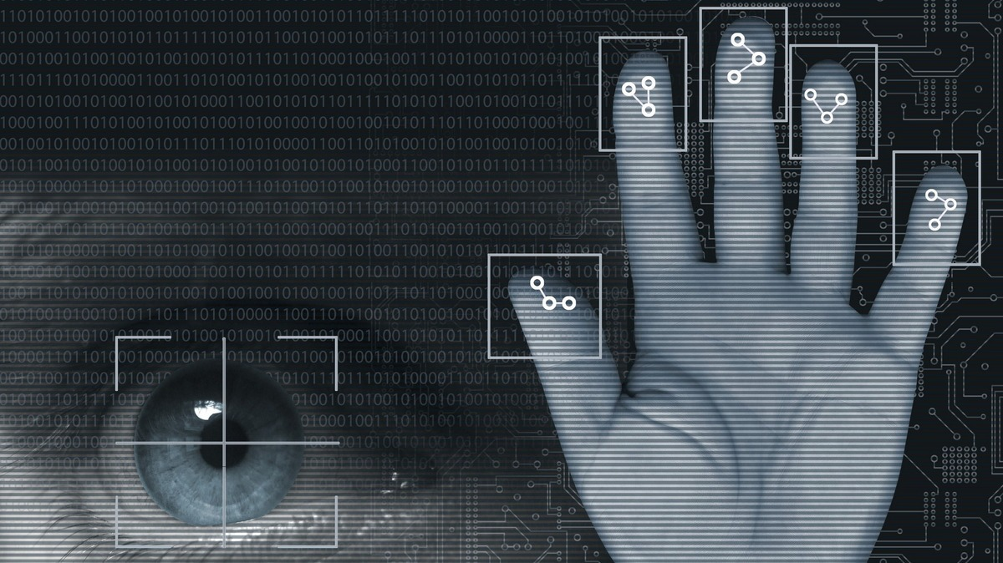
Targetted Innovations
New Biometric Controls
Countermeasures against spoofing Attacks
Next Generation of e-Passport supporting e-Visa and e-Time stamps
Integration of new biometrics in an Automatic Border Control Gate

Slide 10
A major challenge: integration

Slide 11
Business impacts
Demonstration of efficiency and friendliness of new biometrics controls
Integration of new biometrics in an Automatic Border Control gate
Promoting usage of e-Passports
Openness to commercial services (Airline companies, Airline ecosystem)

Slide 12
At the tipping point
EC reveals plans for biometric borders (7/4/16)
An EU Entry-Exit System has been proposed by the Commission on Schengen area’s external borders
  register the name, type of travel document and biometrics
  “smarter borders” eplace the current system of manual stamping of passports.
“Crossing an EU border will never be the same again. It will be automated and will be done through self service kiosks and electronic gates”, suggested Dimitris Avramopoulos, European Commissioner on Migration, Home Affairs and Citizenship .
European Commission also plans to put biometrics at the centre of a bid to reform the EU’s common asylum system: ‘Dublin Plus’.

Slide 13
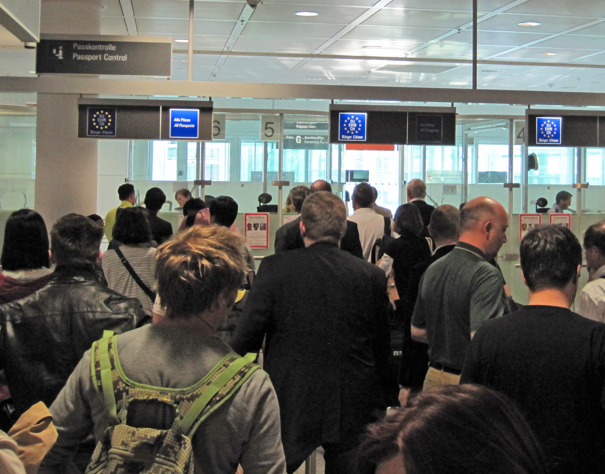

Slide 14
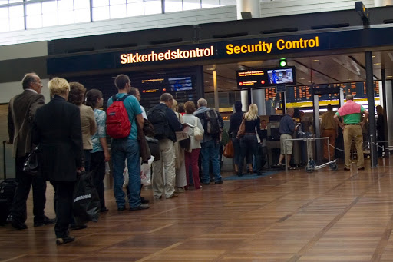
Risks and Respond
2,653 firearms in carry-on bags were detected at airport security checkpoints across the United States, an increase of more than 16% from 2014*
More than 80 countries utilize e-passport programs using biometric identification systems
  Cost-effective
  Fast
  Accurate
Airports that deploy multimodal biometric system result in a faster and more accurate immigration checking

Slide 15
Worldwide initiatives
  Peru (8th February 2016)
  In the next three years; 1.6 Million biometric passports are to be issued, for Peruvians to be able to travel the Eurozone without visa up to 90 days.
  Singapore (5th May 2016=
  120.000 passengers in April 2015 (Tanah Merah Ferry Terminal)
  Enhanced security, faster service are being experienced
Moldava (9th May 2016)
  Updating and modernizing the ID documents.
  Multimodel biometry being used
  Ireland (18th April 2016)
  ABC at Dublin Airport
  Up to 1.000 passengers per day
  App. 7,5 seconds per passenger
  Multimodel biometry used
  NeoFace recognition software is used (high accuracy and selectivity regardless of the database size and image quality )

Slide 16
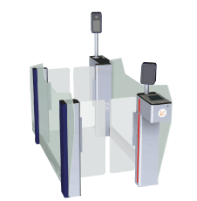
Automated Border Control (ABC) in Europe (BSI - ICAO MRTD Symposium, Montreal, 16 October 2015)
15 European countries have ABC in operation (figures from 2014)
  Total number of eGates : ≈ 450
  Total pax throughput :≈ 25 million
Target group: EU/EEA/CH citizens (32 countries)
  Extension to selected “Third Country Nationals” in some countries
Token: ePassport
  In addition national ID cards in some countries
Biometric modality: primarily face
  Multibiometrics (face and fingerprint) applied in some countries
  “Fingerprint only” is applied in two countries

Slide 17
ABC and Beyond:
Trends in Travel Processes (ICAO Symposium)
The Past
  Hand Written/Typed c1915
  Machine Readable c1980
  Electronic c2005
  Passport Cards
The Future
  Digital Identities
    Mobile ID
      Smartphone Passports
    Virtual ID
      Cloud Passports
Global market for Personal ID credentials: $8.7 billion in 2016
forecast to reach $9.7 billion by 2021 (Smithers group 2016).
  technology drivers will help transform the outlook for passports, national ID cards, driving licences and visas.
  impact of digital identities and of biometric verification on business investment across the sector.

Slide 18
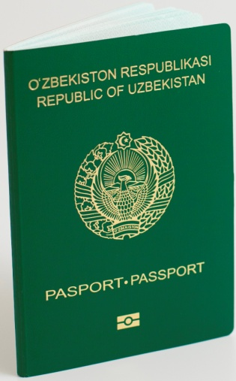
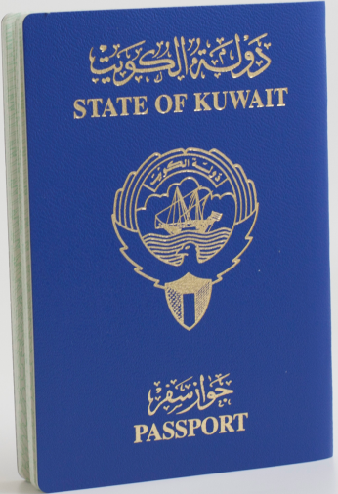
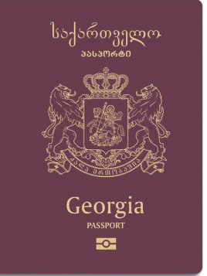
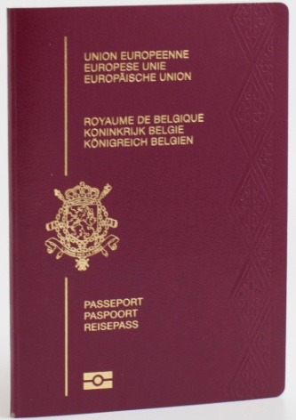
Market (PassPorts)
Passports are no more a subject of credential only, but of integrated end-to-end solutions.
Under ICAO’s initiative and control the 3rd generation of ePassports continues to be adopted by a growing number of countries. However only 120 countries issue ePassports as of 2016, i.e. about 60% of all countries worldwide.

Slide 19
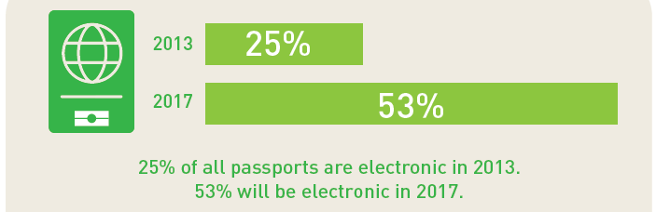
PassPorts
More than 600 millions e-Passports issued since 2015
Air travel Passenger increase more than 40% between 2010 and 2020
More than 100 Airports and 38 countries use Automated Border Control

Slide 20
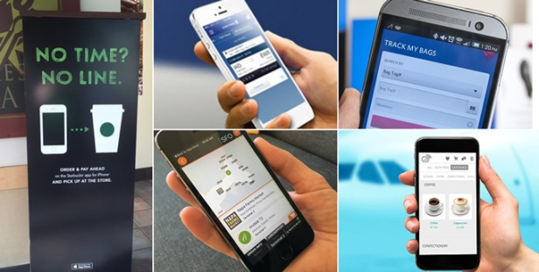
IDEA4SWIFT: towards Digital Innovation and the End-to-End Passenger Experience
Expectations of airline passengers
  how well an airline performs versus its direct competitors
  innovative products and services in one industry raise the bar for all industries.
On Demand
  consumers’ appetite for greater convenience, speed, and simplicity
Real-time
  progress of their journey in real-time.
End-to-end
  evolve Airline app into a ‘digital travel companion’ in order to extend their service beyond just flying passengers from A to B.
Digital eco-systems
  end-to-end digital travel ecosystem

Slide 21
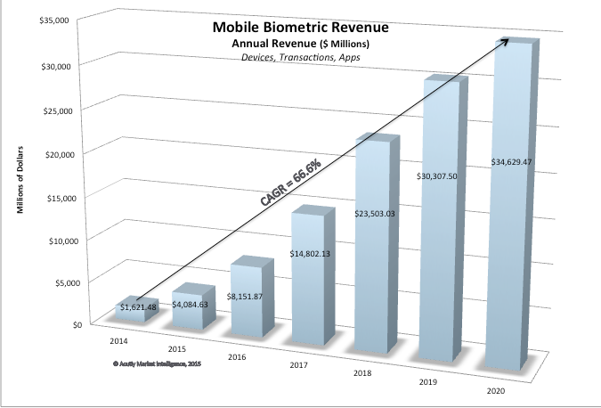
Biometric Market: Convergence of Mobility and Privacy
By 2020, biometrics standard 100% of 3 billion consumer smart mobile devices sold each year.
base of 4.8 billion, more than 89% biometrically enabled.
more than 5.5 billion biometric apps downloaded annually,
more than 800 billion transactions (Acuity Market Intelligence June 2015)
Governemental
  Border Control
  National ID
Entreprise
  Access Control
  Private/Public Cloud
Personal
  Payments/transactions

Slide 22
Achievements
Match On Card- Card version for eBoarding (Oberthur, ID3)
The Development of the fusion engine (Mozaic with the support of Proline, Morpho, Eurecom)
EURECOM worked on gender recognition
3rd e-Passports Gemalto Very first interoperability test session in collaboration with Oberthur and Morpho
Eectronic visa application both on smart card and terminal (Smartsoft)
High improvement of the fingerprint reconciliation for the product Finger-on-the-Fly(Morpho)
Full recognition system of iris-at-a-distance - Full System of finger-vein verification system (TSP)

Slide 23
Efforts

Slide 24
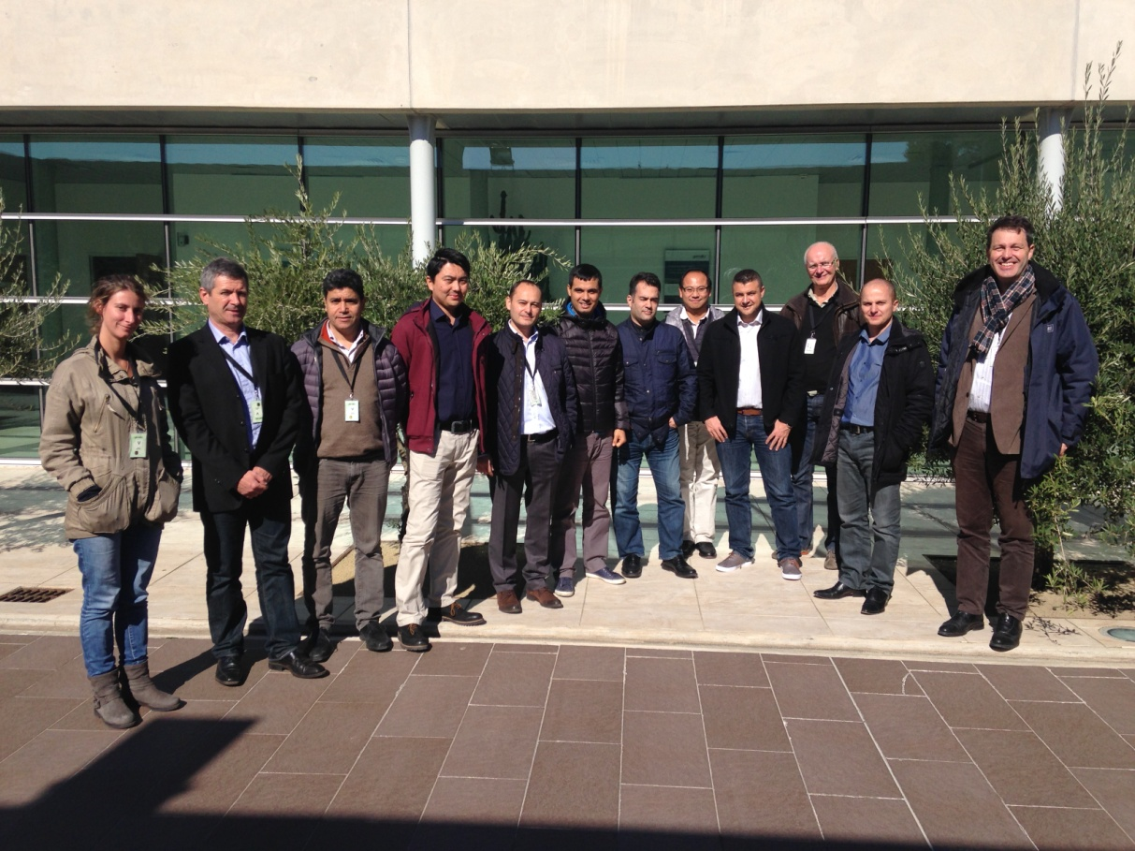
WP1: Management
General Assembly Meeting
  Istanbul June 2015 at Proline Premises
  La Ciotat October 2015 at Gemalto Premises
  Nanoinnov (Saclay) January 2016 hosted by TSP

Slide 25
Project original plan

Slide 26
Project actual plan

Slide 27
IDEA4SWIFT
2ndYear Review 12th May 2016
WP-3 BIOMETRY

Slide 28
IDEA4SWIFT WP3: Biometry
WP start date: T0+1
WP end date: T0+16
Objectives
Providing the most suitable technologies for the use-cases under the scope of the project.
Proposing solutions for improving current biometric e-gates
  Increase the flow
  Provide good efficiency at a reduced cost
  Increasing security through spoof attack detection
Tasks
Task 3.1: Up-to-date Sensor Technologies
Task 3.2: Multiple Modalities and Fusion
Task 3.3: User constraints, Biometrics on the move
Task 3.4: High robustness & security
Task 3.5: Efficient implementation

Slide 29
IDEA4SWIFT WP3: Biometry
Updates on Deliverables
2014 Q4 D3.1 Sensor State of the art Report (Eurecom)
  Document describing a SoA of new sensors on the market that are relevant for the biometrics considered in this project
2014 Q4 D3.2 Algorithms and Fusion detailed Design Document
  Document describing one or several algorithms for each Biometrics used in the project, and associated assessment results. multimodal fusion results will also be presented.
2014 Q4 D3.3 Biometrics on the move specifications Document (TSP)
  New iris algorithms taking into account the degradation inferred by a walking person.
2016 Q1 D3.4 Implementation on Acquisition Devices (software) (Proline)
  The chosen Algorithms will be implemented on the acquisition devices to be used in the final demonstrator
    Demo on all acquisition devices (Proline : Face Verification for Border control scenario)
2016 Q1 D3.5 Implementation on passports or Secure elements (software) (Oberthur)
  The chosen Algorithms will be implemented on e-Passports or Secure Element to be embedded in a mobile phone to be used in the final demonstrator
  Oberthur: Demo (Match on Card : Fingerprint)
Final Review: Morpho
Final Review: Whole Demonstrator

Slide 30
IDEA4SWIFT WP3: Biometry
Updates on Deliverables
2014 Q4 D3.1 Sensor State of the art Report (Eurecom)
  Document describing a SoA of new sensors on the market that are relevant for the biometrics considered in this project
2014 Q4 D3.2 Algorithms and Fusion detailed Design Document
  Document describing one or several algorithms for each Biometrics used in the project, and associated assessment results. multimodal fusion results will also be presented.
2014 Q4 D3.3 Biometrics on the move specifications Document (TSP)
  New iris algorithms taking into account the degradation inferred by a walking person.
2016 Q1 D3.4 Implementation on Acquisition Devices (Proline)
  The chosen Algorithms will be implemented on the acquisition devices to be used in the final demonstrator
    Demo on face, finger vein and print (Proline : Border control scenario)
2016 Q1 D3.5 Implementation on passports or Secure elements (Oberthur)
  The chosen Algorithms will be implemented on e-Passports or Secure Element to be embedded in a mobile phone to be used in the final demonstrator
    Oberthur: Demo (Match on Card : Fingerprint)
Iris Demo TSP
Finger on the Fly (Morpho)
Eurecom: Gender Recognition

Slide 31
IDEA4SWIFT WP3: Biometry
Collaboration of Partners
Face
  Proline (Core Recognizer)
  Eurecom (Soft Biometrics: Gender, Make up, Age)
Iris
  Morpho (Core Recognizer)
  Telecom SudParis (Open reference system, OCT → Antispoofing)
  Mozaik

Slide 32
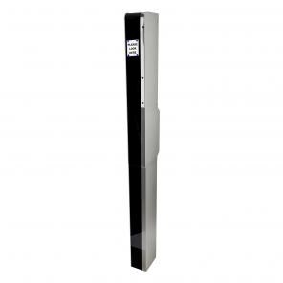
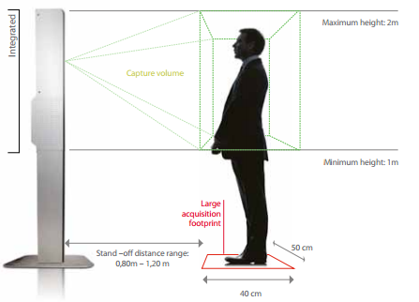
WP 3 : Iris at the Distance
Improvement of the ergonomic
  Live detection and quality evaluation in order to improve the field of depths.
Improvement of the accuracy
  Allows to increase security
  But also allows to improve robustness.
Acquisition and matching time decrease:
  Multithread algorithm implementation for parallel process : 2 eyes are acquired at the same time, but are processed separately. First eye to match will grant the access.
  3 sec –> 1 sec

Slide 33
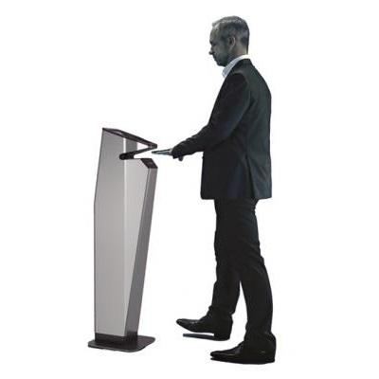
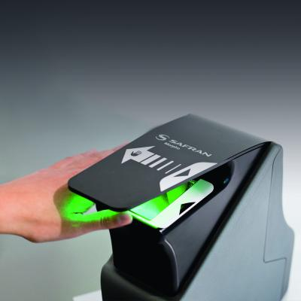
WP 3 : Morpho Wave
Standard compliancy for compatibility with border control standard : ICAO – IQS: this standard was not compatible with the device -> new definition with FBI – Mitre.
Improvement of the accuracy
  Allows to increase security
  But also allows to improve robustness.
Acquisition and matching time decrease:
  New matching architecture for live recognition under 1sec

Slide 34
WP4: Security

Slide 35
WP4 Security - Description
Automatic Border Control security solutions
  At the architecture level,
  At the integration level,
  At the evaluation level,
Start : T0 (Q3-2014)
End : T0+16 months (Q1-2016)
Notes:
At the architecture level,
by identifying assets and proposing solutions to manage them and ensure their security
At the integration level,
by analyzing impact on functional aspects and on performances, especially regarding 3rd and 4th generation of ePassport
At the evaluation level,
by a risk analysis of user data and trade assets for the use cases under consideration in the project, and by designing recommendations to enforce applications and systems.

Slide 36
ICAO – TRIP
Traveler Identification Program
Global fight against fraud by securing all the links in the security chain.

Slide 37
WP4 Security – Task 4.1
  Task 4.1: Security requirements and secure documents requirements
  Who:
    Gemalto (on eDocument security aspects, task leader)
    Morpho (on eGate security aspects),
    Oberthur (on biometrics & embedded devices security aspects),
  What:
    activities related to secure mechanisms enabled for electronic travel documents (authentication and privacy enforcement)
    deliver specifications for protocols compliant with the rules of the domain
    prototype the implementation on ePassport or other embedded devices.

Slide 38
WP4 Security – Task 4.1 – Activity
Activity performed during the period
  Gemalto, Oberthur and Morpho have cooperated to produce the security requirements document
  D4.1 Security Requirement document v1.0 has been released
    eDocuments security requirements
    Biometry security requirements
    eGates security requirements
    IDEA4SWIFT_WP4-D4.1_Security_v1.0.pdf
  Gemalto, Oberthur and Morpho have also performed cooperative tests sessions to ensure interoperability and compliancy of eDocuments toward the new version of ICAO LDS2 standard

Slide 39
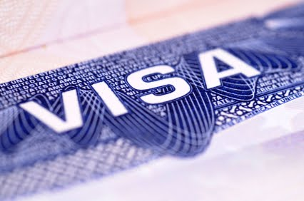
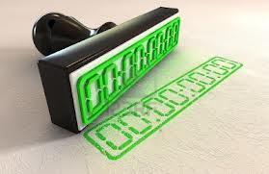
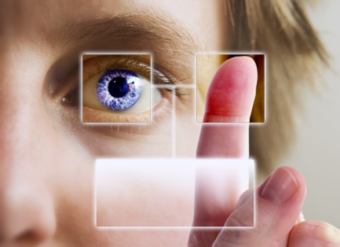
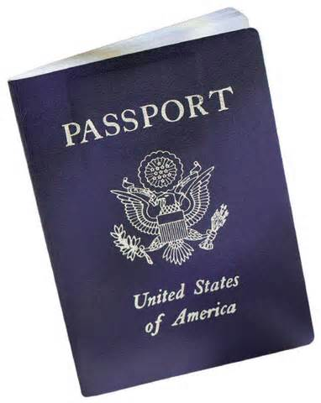

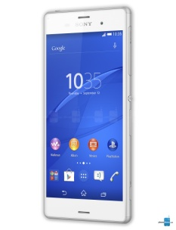
WP4 Security – Task 4.1 - Results
4G ePassport:
  Electronic Visa storage
  Electronic Time Stamping
  Additional biometrics
  Exploration of new use cases with mobiles
    Boarding pass secure storage
    Luggage ticket secure storage,
    Access control to IT Systems
    …

Slide 40
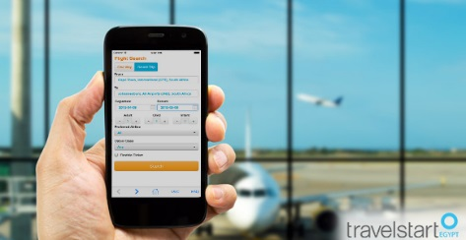
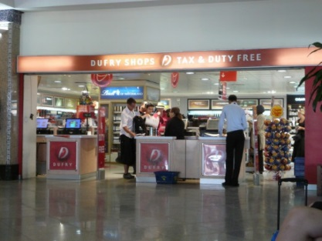







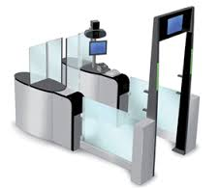



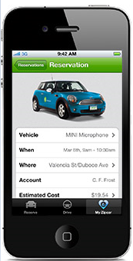

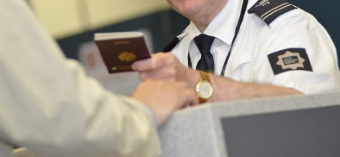




4G ePassport Use Cases
Flight booking
eVisa request
Duty free tax check
4G
Hotel check-in
Border control exit check
Target area
Airport
Home
eVisa entry check
Hotel
Car rental check-in
Improvements
VIP Lounge check-in
Automated
Faster

Slide 41
WP4 Security – Task 4.2
Task 4.2: Security of Biometrics
  Who: Oberthur (task leader)
  What:
    Securization of biometric technologies concepts developed in previous workpackage will be considered.
    Embedding the biometry on mobile device and the usage in a Border Gate generates new weakness.
    As there is already a strong state of the art on this specific subject very specific techniques will be targeted and evaluated.

Slide 42
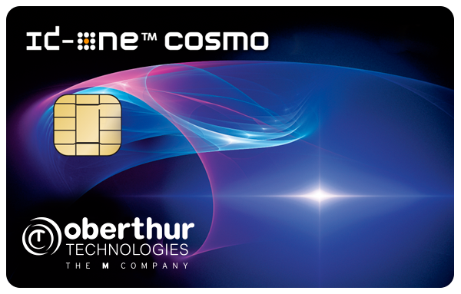
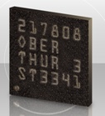
WP4 Security – Task 4.2 - Activity
Activity performed during the period
  Oberthur has implemented and integrated the MoC designed and developed by ID3 (WP4) in an LDS V2 application
  The first integration as been done on an ID One Cosmo 128 Dv7.0-n card
  Next step will be done on an embedded SE to deploy the solution on a mobile phone

Slide 43
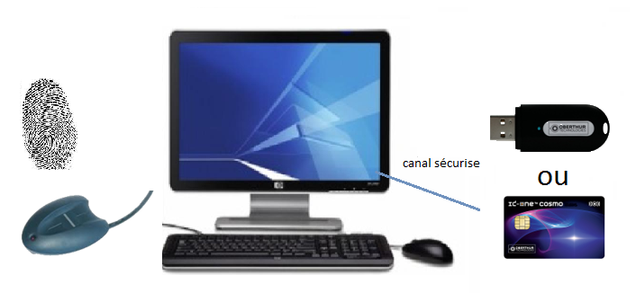


WP4 Security – Task 4.2 - Results
Results obtained
  Automatic Boarding Demonstration
    Secure Enrollement: Identity derivation
    Automatic Boarding: Strong Authentication

Slide 44
WP4 Security – Task 4.3
Task 4.3: Security of System: Front end station, Back End System, Infrastructure
  Who: Morpho (task leader), Oberthur, SmartSoft
  What:
    consider all the threats related to the gate, enrolment and matching
    Emphasis on the front end station as we want to introduce innovation proposals for Frequent Travelers Management
    important to consider the system as whole.
    sensitive software components that will be integrated in next workpackage, as Identity Management, will be developed during this task.

Slide 45
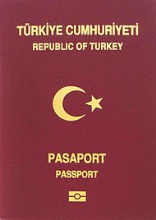


WP4 Security – Task 4.3 - Identity Derivation
Secured communication between system and passport
Strong identity verification.
Derived Identity creation
Secured protocol development between central server / mobile / devices.
MOC verification
Passport verification
Derived identity creation and storage
Traveller fingerprint live capture
Matching against passport fingerprint

Slide 46
WP 4 Security – Task 4.3 - Results
Biometric Data :
  New Template definition and compacting in order to reduce the image size without decreasing the accuracy.
BioHashing
  Encryption using biometric as a key.
Cancelable Biometrics
  Biometrics template encrypted with a token key. In case of integrity suspicion, the token can be rejected what will cancel the biometric template

Slide 47
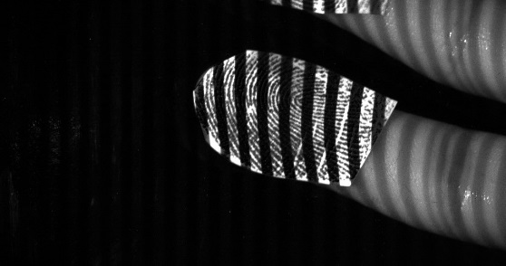

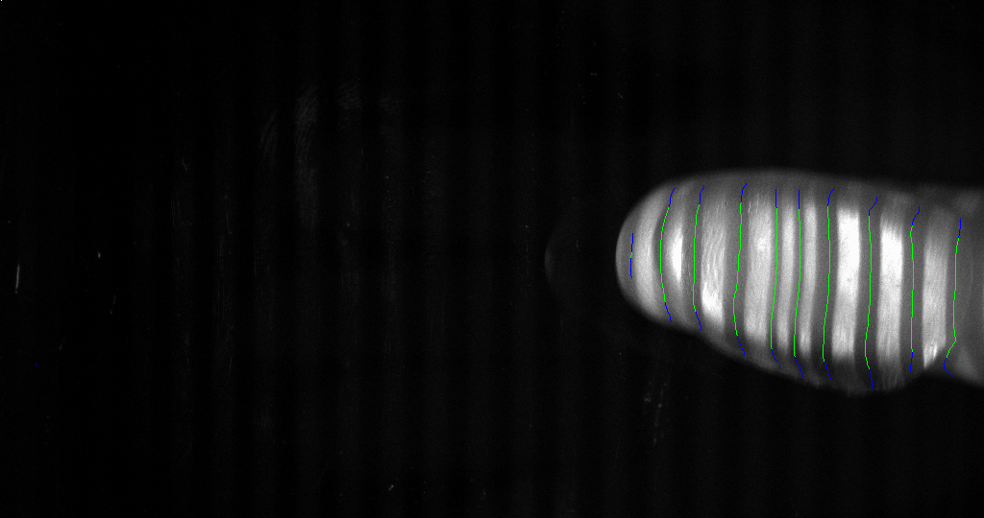
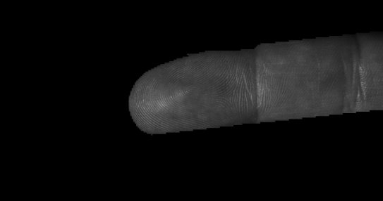
WP4 – Task 4.3 - Spoofing Detection
3D analysis and classification for spoofing detection
Light diffusion analysis and classification

Slide 48
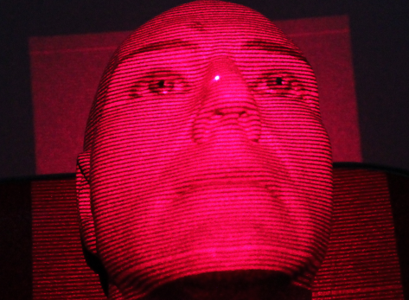
WP4 - Task 4.3 - Spoofing Detection
3D analysis
Speckle analysis and Light diffusion analysis and classification

Slide 49
WP4 Security – Deliverables
done
D4.1 Security Requirement document
  Considering the architecture document this document should determine which policy, tools, requirements and regulations apply to achieve the best security for border control. A unique document will gather requirements for Documents, Biometry & System
  When: Q4 2013 (Initial date) => Proposed deadline: Q3 2015
D4.2 Communications protocols Implementation (confidential)
  Secure protocols designed or recommended by task 7.1 will be implemented on prototypes of the partners. As this work is very sensitive in term of intellectual properties they will be provided embedded in devices used by the demonstrators
  When: Q1 2014 (Initial date) => Proposed deadline: Q1 2016
D4.3 Biometrics Securing tools (confidential)
  Some tools consider as efficient can be implemented in task 7.2. As for the previous deliverable
  When: : Q1 2014 (Initial date) => Proposed deadline: Q1 2016
done
done

Slide 50
Thanks for your attention

Slide 51
MoC Demonstration
Oberthur-ID3

Slide 52
Use case: boarding fast-track for frequent flyers
Provide automatic boarding for registered frequent flyers
Components:
  Frequent flyer: standard eMRTD (typically Passport) and frequent flyer card with Match-On-Card technology
  Airline kiosk with biometry support, providing identity derivation from eMRTD to frequent flyer card
  Kiosk at the boarding gate, allowing identity and boarding information verification based on the frequent flyer card

Slide 53
Step 1: activation
Frequent flyer card shipped to the cardholder with the fast boarding option deactivated
Activation performed at an airline office
Fingerprint enrollment and storage in the card for Match-On-Card application
Opt-in
Performed once

Slide 54
Step 2: Identity Derivation
MOC verification
Passport verification
PACE, EAC
Fingerprint extraction
Derived Identity creation and storage
Passport’s MRZ, boarding data,
Validity scope (location & time),
Signature
Passenger fingerprint live capture
Matching against passport fingerprint

Slide 55
Step 3: automatic boarding
Card Authentication
Integrity Verification
Data Reading
Passenger fingerprint live capture
Match-On-Card verification
Boarding data check (flight number, gate, passenger name)
Validity check (location, time)
Boarding authorized

Slide 56
Future extensions
Identity Derivation step integrated in self-check-in kiosks
Frequent flyer card hosted in a mobile phone with eSE

Slide 57
WP3: On-Card Biometrics
Fingerprint On-Card Comparison
  Improved algorithm
  NIST MINEX III compliance
  Implementation on a smart card from Oberthur
  Face On-Card Comparison
  Improved face recognition algorithm, based on advanced deep learning methods
  Small template size : 512 bytes
  Implementation on smart card is pending
On-Card Fusion
  Score-level fusion of several fingerprint comparisons

Slide 58
WP4: Security of On Card Biometry
Technology Advantages
  Secure authentication
  Privacy protection, no database, biometric data remains on the card
  Fast and reliable
  Flexible and scalable

Slide 59
IDEA4SWIFT
2ndYear Review 12th May 2016
WP-5 AUTOMATİC BORDER CONTROL FRONT END

Slide 60
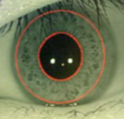
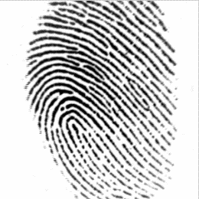

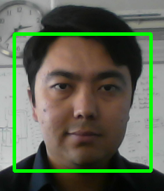
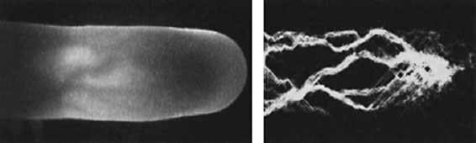
WP 5 Automatic Border Control Front End
Aim of Automatic Border Control System
Fast and Secure Border Control System
Smart Card & NFC Technology
Multi Model Biometry
Make up Detection
Multi Model Fusion Framework – Face, Fingerprint, Finger vein and Iris
Test Environments
Generic Biometric Data
High Secure Algorithms and solutions

Slide 61
WP5 – Time Line
IDEA4SWIFT WP5 - AUTOMATIC BORDER CONTROL PLATFORM |  |  |  |  |  | 2015 |  |  |  |  |  |  |  |  | 2016
No | WBS | Milestones | Source |  | T | 4 | 5 | 6 | 7 | 8 | 9 | 10 | 11 | 12 | 1 | 2 | 3 | 4 | 5 | 6 | 7 | 8 | 9
1 | 0 | WP5 | Mozaik
2 | 1 | Smart Card and Technologies
3 | 1.1 | Investigation of Smart Card Technologies | Proline
4 | 1.2 | Card Reader Technologies | Proline
5 | 1.3 | NFC Technologies | Proline
6 | 1.4 | NFC Readers and Specs | Proline
7 | 1.5 | Security Specs | Proline
8 | 1.6 | Smart Card & NFC Interface Development | Proline
9 | 2 | eGate Management System
10 | 2.1 | eGate Integration | Proline
11 | 2.2 | eGate Management System Interface | Proline
12 | 3 | Demonstration Process
13 | 3.1 | Demo Area Location | Proline
14 | 3.2 | Access Right | Proline
15 | 3.3 | Installation on Air Port | Proline
16 | 4 | Data Fusion
17 | 4.1 | Developt Fusion Engine | Mozaik
18 | 4.2 | Create Test Data | Mozaik
19 | 4.3 | Face Biometric Weight Tests | Mozaik
20 | 4.4 | Make up Effects | Eurecom
21 | 4.5 | Fingerprint Biometric Weight Test | Mozaik
22 | 4.6 | Fingerprint score data | Morpho
23 | 4.7 | Iris Biometric Weight Test | Mozaik
24 | 4.8 | Irıs matching score | SudParis
25 | 4.9 | Finger vein Weight Test | Mozaik
26 | 5 | Test Data
27 | 5.1 | Data Fusion for Face & Fingerprint | Mozaik
28 | 5.2 | System Test for Demontstration | Mozaik

Slide 62
WP5 – Process of the Work Package
Face Biometry Analysis
Fingerprint Biometry Analysis
Alternative fusion method investigation
Constructed face Database for fusion engine
Constructed Fingerprint DB for Fusion engine
Iris DB Preparation
Eurecom NDA and make up detection ,
Constructed make up DB , still in process
Telecom SudParis Iris C based library update to C++
Morpho Fingerprint results
Proline Face Matching Score.

Slide 63
WP5 – Fusion Training

Slide 64
WP5 – Enrollment Platform

Slide 65
WP5 – eGATE Platform

Slide 66
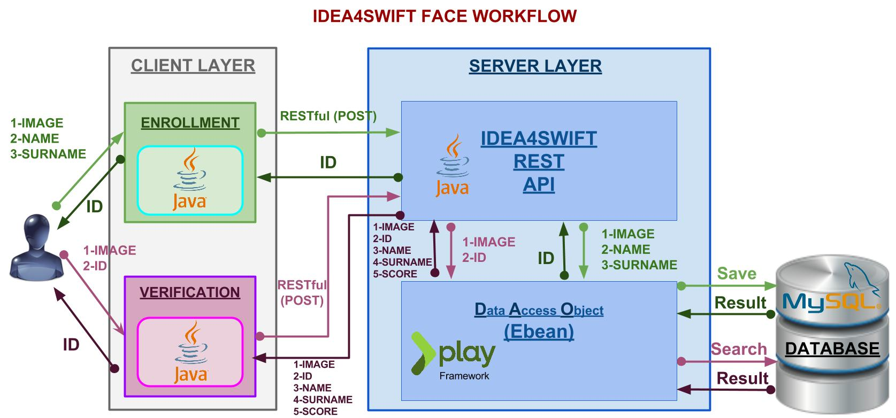
Proline: Face Enrollment & Verification

Slide 67
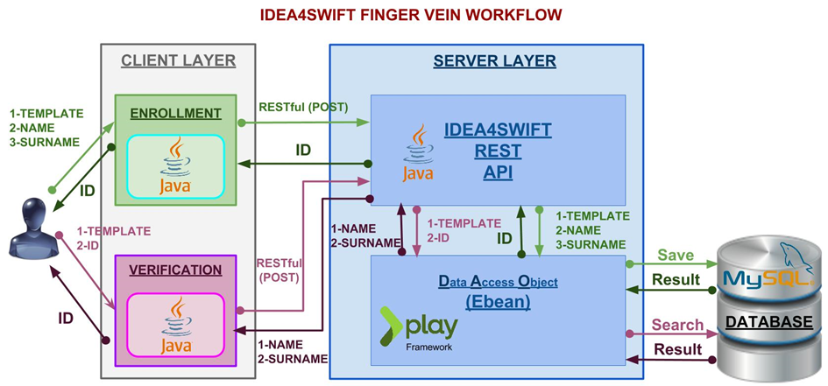
Proline: Finger Vein Enrollment & Verification

Slide 68
EURECOM Time Plan
Database collection and impact analysis
Transfer of the code to Mozaik
…
2015
2016
Development of basic version of the makeup detector
Code optimization

Slide 69
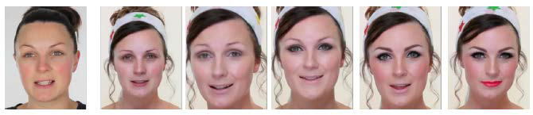
Facial Cosmetics Database
Features:
consists in total of 389 images from 50 different persons;
to ensure similar conditions as in real world scenarios, images are taken from YouTube videos;
each image is annotated with the amount and location of applied makeup i.e. the makeup code.
Makeup Category | Effect
No | No makeup applied, no effect
Slight | Slight changes in perceived color and shape
Intermediate | Enhancement of characteristic features
Heavy | Estrangement from personal characteristics, mask-alike, artificial

Slide 70
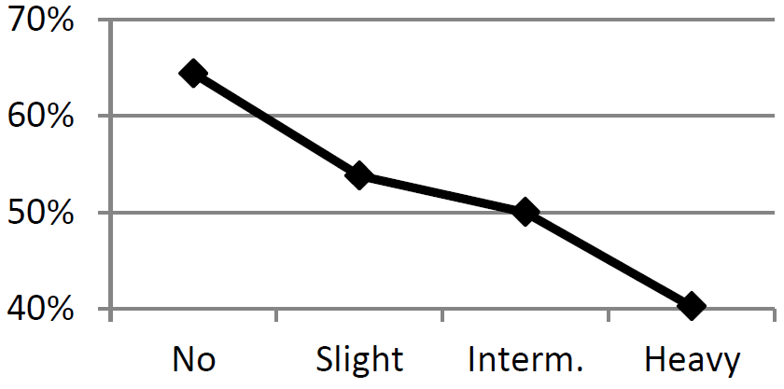
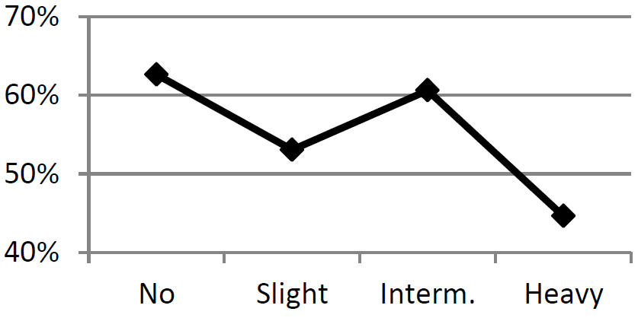
Impact Analysis on Automatic Face Recognition
To analyze the impact of facial cosmetics, identification rate is computed:
Fig. 4 confirms that facial cosmetics have a negative impact on automatic face recognition.
Intermediate makeup has no negative impact when applied to the eye area (Fig. 5) which plays the most important role in face recognition.
Fig. 4. Identification rates for face
Fig. 5. Identification rates for eyes

Slide 71
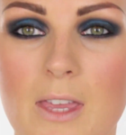
Facial Makeup Detection
The performance of the proposed technique is tested using three publicly available facial makeup databases:
  YouTube Makeup (YMU) Database – 604 images from 151 subjects;
  Makeup in the “wild” (MIW) Database – 154 images from 51 subjects;
  Facial Cosmetics Database (FCD) – 389 images from 50 subjects.
A texture descriptor (LGBP) and a shape descriptor (HOG) are used to extract the features;
SVM and Alligator classifiers are employed to detect makeup.
Best performances were obtained by Alligator : 98.73% classification accuracy
LGBP_{8,2}^{u2}
5x5 blocks
Face with Makeup
…
Classifier
HOG
5x5 blocks
Face without Makeup

Slide 72
WP5 – AUTOMATİC BOARDER CONTROL PLATFORM FRONT END
THANK YOU

Slide 73
IDEA4SWIFT
2ndYear Review 12th May 2016
WP-7 DISSEMINATION

Slide 74

Advertising materials
New logo, brochure and link to the website.
http://idea4swift.eurecom.fr/content/idea4swift

Slide 75
Publications
Othman, Nadia; Dorizzi, Bernadette, Impact of Quality-Based Fusion Techniques for Video-Based Iris Recognition at a Distance, IEEE Transactions on Information Forensics and Security (TIFS), 2015.
Kose, Neslihan; Apvrille, Ludovic.; Dugelay, Jean-Luc, Facial Makeup Detection Technique Based on Texture and Shape Analysis, IEEE International Conference on Automatic Face and Gesture Recognition FG 2015, May 4-8, Slovenia.
Othman, Nadia; Houmani, Nesma; Dorizzi, Bernadette, Quality-Based Super Resolution for Degraded Iris Recognition, in Advances in Intelligent Systems and Computing, Series “Pattern Recognition Applications and Methods”, vol. 318, Springer, Jan. 2015.
Qin, Huafeng; El-Yacoubi, Mounîm A., Finger-vein quality assessment by representation learning from binary images, 22nd International Conference on Neural Information Processing (ICONIP), Istanbul, Turkey, 2015.

Slide 76
Participation to events
*March 30th, 2016 (Montreal)* : Gemalto, Morpho and Oberthur have promoted IDEA4SWIFT new secured documents technologies (LDS2) to the ICAO TAG (Technical Advisory Group) on Traveller Identification Programme. Interoperability and level of security of the technology proposed has been demonstrated. The new LDS2 will be included in a future version of ICAO 9303 standard.
*March 3th/4th, 2016 (Limassol, Cyprus)* : EURECOM has showed in IWBF2016, organized by COST Action IC1106 (Integrating Biometrics and Forensics for the Digital Age) a demo on gender recognition from face and full body.
*November 6th, 2015 (Bangkok)* : Gemalto has promoted IDEA4SWIFT new secured documents technologies (LDS2) into the ICAO (International Civil Aviation Organization) NTWG (New Technical Working Group) especially on eDocument and Inspection System Tools aspects. Logical Data Structure 2 (LDS2) provides the optional capabilities to write visa, travel, or biometric information to the eMRTD’s chip after issuance.

Slide 77
Posters and Demonstrations
EURECOM has presented a poster in IWBF2016 describing a demo focus on gender recognition from face and full body. The same poster will be presented in the 13th IAPR/IEEE/Eurasip Int.l Summer school for advanced studies on biometrics:
Biometrics, Forensic Science and the Quest for Identity in Italy next June.

Slide 78
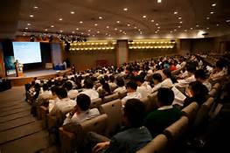
Agenda 2016-2017
Meet the main objective of IDEA4SWIFT: demonstrate the functioning of the IDEA4SWIFT e-Gate in an operational environment
  Attendance of a conference:
    Validate research work against the scientific and technical community
    Evangelize about the opportunity to add new Biometric modalities in Border Control and the requirements about a high level of security
  A strong support for communication
    Making a video
      Assurance to complete and validate the architecture
      Good experience from partners in other projects
  Meet the End Users
    Customs officer police (contact with Turkish Police, Belgian Customs STSI² in France)
    Airlines, Airport
    Dedicated workshop at Morpho’s premises before the last review

Slide 79
Conclusion
Achievements in this second year includes strong innovations in Biometrics and security technologies
Project Progress has been satisfying.
We have now the components required to reach our ambition: integration of the gate and have confidence we can succeed
The consortium works with a good spirit of collaboration

