Slide 1
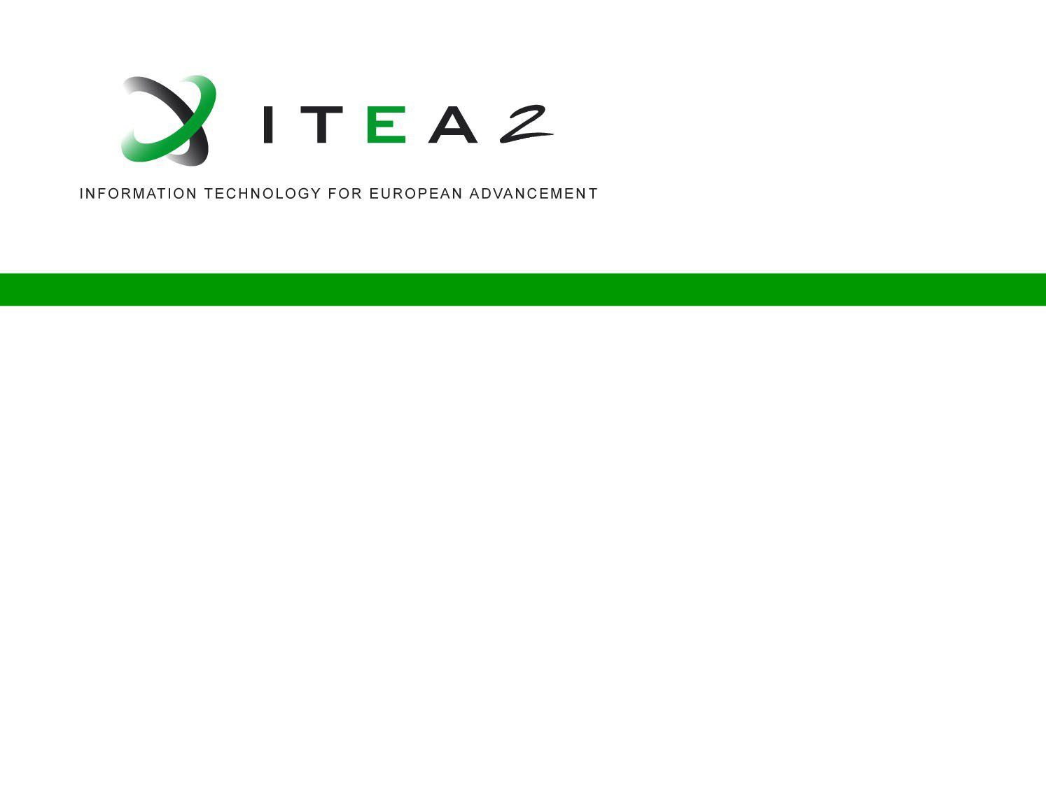
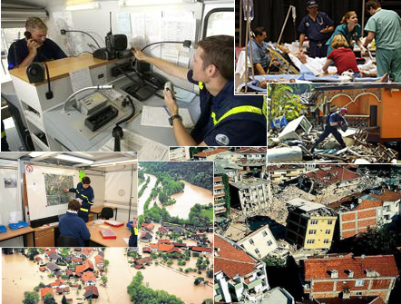


DICOMA
DIsaster COntrol
MAnagement
Co-summit 2012
30 & 31 October, Paris - France
Eloy González Ortega
Indra Software Labs

Slide 2
Introduction & Relevance
Project scope & Objectives
Data Abstraction tools: A Comprehensive set of tools designed to process and correlate information.
Simulation & Modelling Tools: Suite of simulation tools that model both human behaviour and natural phenomena.
Decision Support & Training tools: Tools that provide easily & quickly understood information to the decision maker and propose alternative actions.
Options
Data
Training
Better Decisions

Slide 3
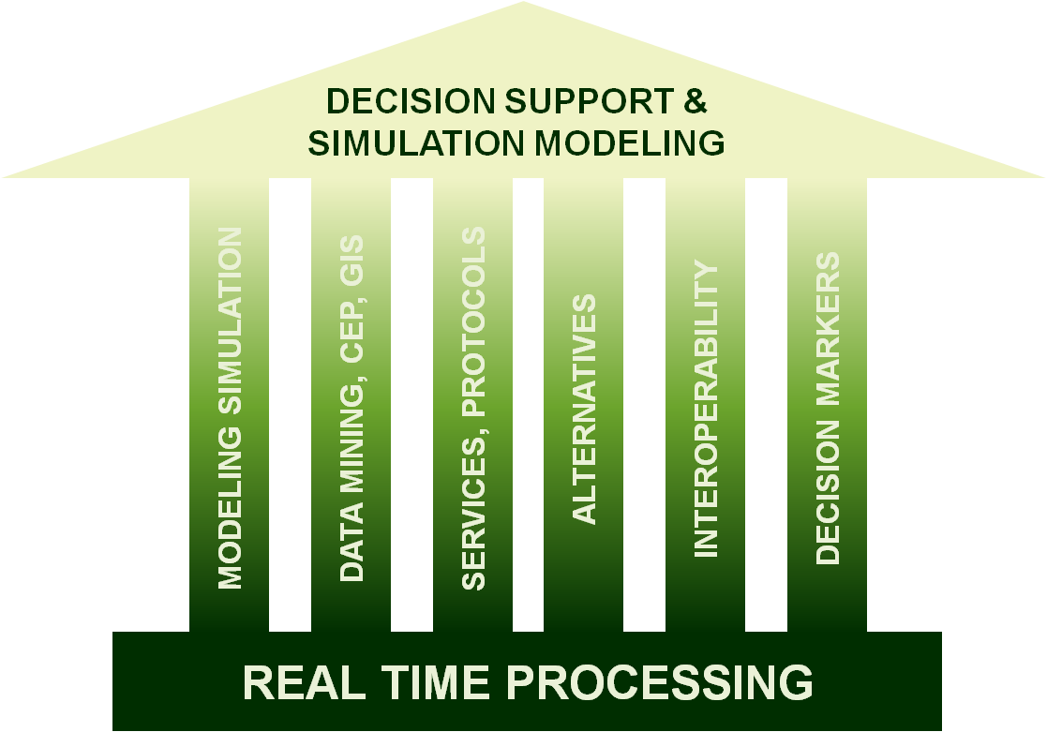
Innovation
Technical Challenges & Business Impact
Decision support: event and human behaviour modelling, sharing physical resources and information.
Control & Decision Support Systems: rule based knowledge discovery, Geographic Interface System platform, Data Mining, Advanced Human Computer Interaction.
Real Time Data Processing: inter-agency data and resource sharing, Complex Event Processing, Event prediction and Modelling.

Slide 4
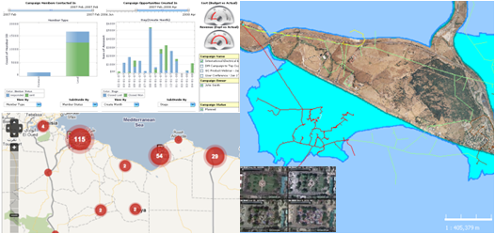
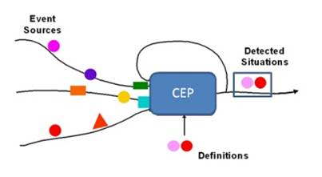

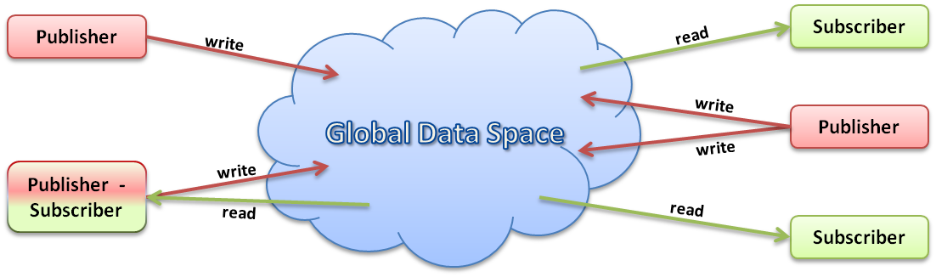
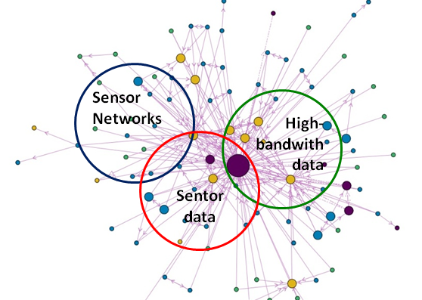
Technical solutions
Dicoma Approvals
Control & Decision
  Analyze political, social and cultural implications of decisions
  Effect on human lives and life quality
Simulation
  Analyze alternatives
  Generate options for decision makers
Data Processing
REAL TME &
NON REAL TIME
  Generate options
  Generate a Common
  Operation Picture
v
Data &
Sensors
  Interoperatibility
  Language and cultural
  barriers
REAL TME &
NON REAL TIME
  Information sources
  Communications

Slide 5
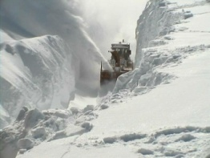
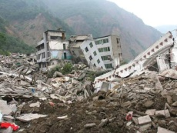

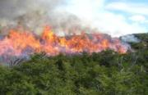
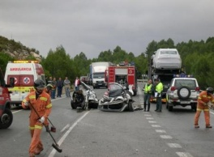
Technical solutions
Scenarios
HEAVY WINTER STORM
EARTHQUAKE
AIRCRAFT CRASH
FOREST FIRE
CHEMICAL GOOD CRASH

Slide 6
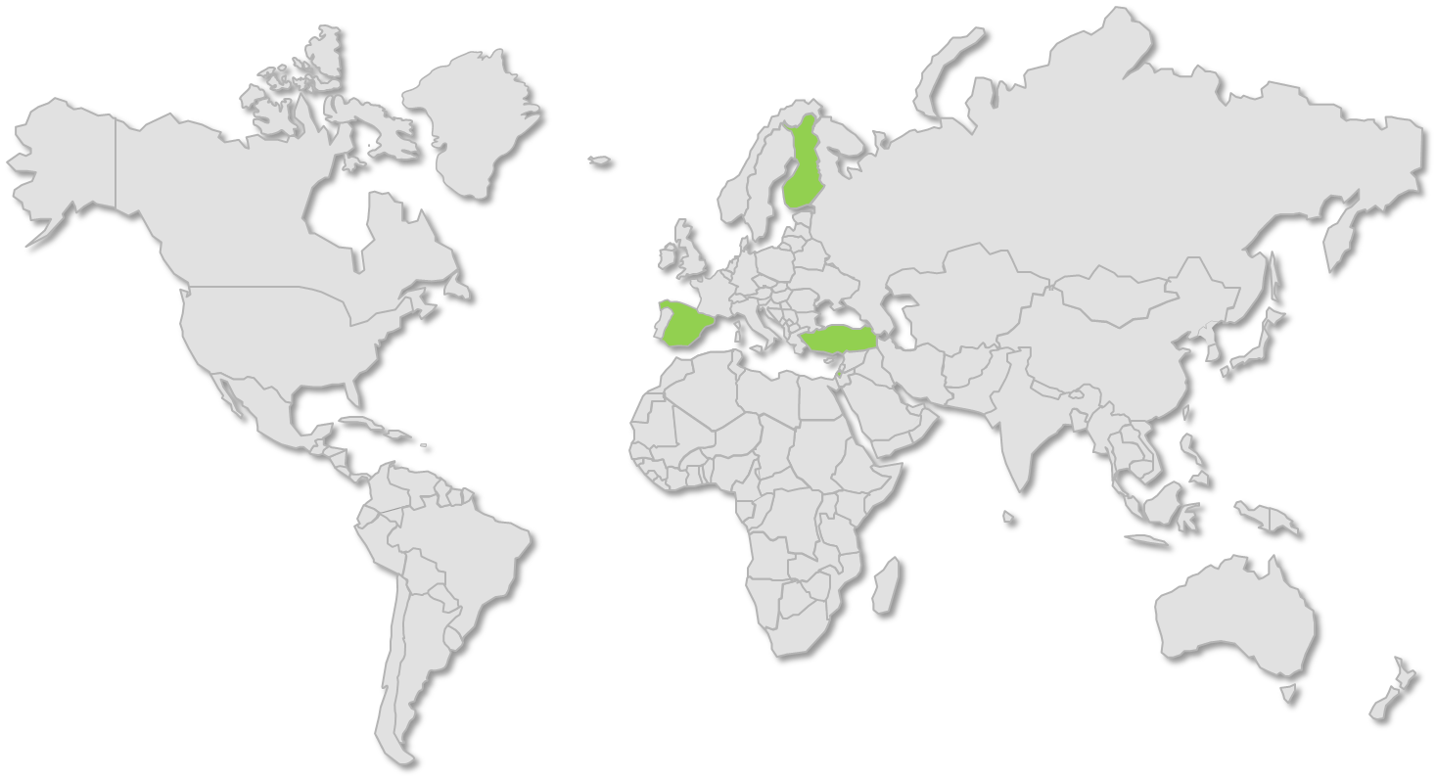















Project Consortium
Project Partners
FINLAND
TURKEY
SPAIN
ISRAEL
January 2012 – May 2014

Slide 7
Thank you for your attention
We value your opinion and questions

